Slide 1

Speaking portal project – team b Requirements presentation
Team Members:
Sarvagya Pandey
Cooper Smith
Mawanli Cui
Yash Atreya

Slide 2
Project description
An add-on to Kukarella’s existing web platform to pair with the company’s text-to-speech(TTS) software.
Involves the generation of an animated video from a user-uploaded image of a person or character’s face narrating the given text.
Provides the user with an embeddable video file for download.

Slide 3
Target user groups
Internet users for personal use.
Professional users in fields such as education or technology for use in lectures, meetings, training etc.

Slide 4
Project requirements

Slide 5
Functional Requirements
Accept input text either by submission through a text box, or by reading a text file of supported type uploaded by the user.
Accept one or more input images of supported file types uploaded by the user.
Provide a list of available languages for the user to select from.
Provide a list of available voices for the user-selected language.
Request for speech file to be created through an API request.
Create animated 2D or 3D video based on user input and speech file.
Provide an embed link for the generated video and a button for the user to copy this link.
Provide user with an option to download the generated video.
Reject user input and display appropriate error messages if unsupported file types are detected for text or image uploads.

Slide 6
Non-functional requirements
Performance – Portable software and fast generation of animated video.
Code Quality – Code must be professionally formatted, linted and maintained.
Robustness - Handles incorrect/invalid inputs.
Efficiency - Maximum utilization of resources for fastest response times.
Accuracy - Accurate syncing of animated video character to TTS audio.

Slide 7
User requirements
Users can enter the text that they want to convert either through typing or by uploading a text file.
Users submit the input image(s) by browsing their local files and uploading it.
Users can view a list containing all available languages for the audio and select their desired language.
Users can view a list containing all available voices for the selected language audio.
Users can play a test/sample for each voice and select based on their preferences.
Users can request the video to be generated by clicking on a confirmation button.
Users can view the generated video.
Users can copy the embed code/link for the generated video.
Users can download the generated video.

Slide 8
Constraints and risks
Inexperience with animation and animation software.
Time constraints: Limited time to complete the project, students need to focus on other courses every week.
Poor team communication.
Animation quality not meeting client standards.

Slide 9
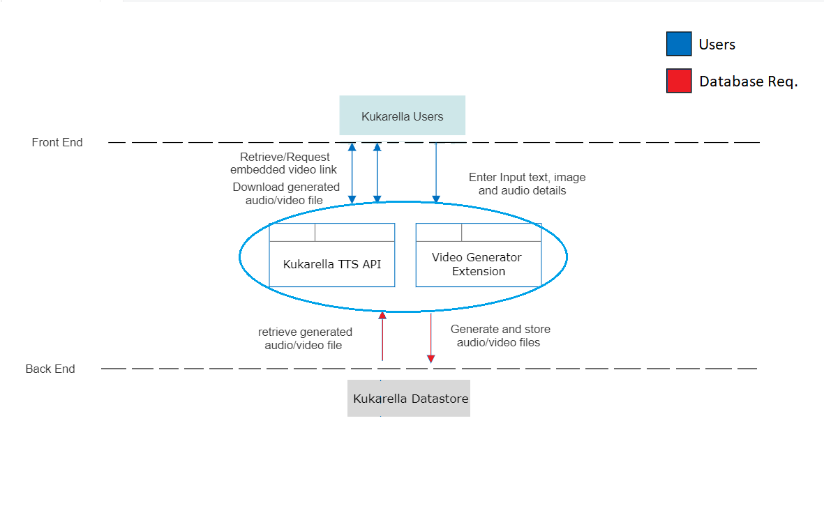
Data-flow diagram

Slide 10
Choice of tech stack
Language of choice - Python.
Most of our group members are familiar with python.
It has a lot of Natural Language Processing libraries.
Ongoing research to determine the various frameworks that will be required.

Slide 11
Testing strategy
Merging directly to main branch on GitHub prohibited.
Min. 2 approvals required for Pull requests.
Unit Testing
Continuous Integration through GitHub Actions workflows.

